Slide 1
Before we start…
The submission includes three notebooks: WGAN, GAN-L1, and GAN-MSE. Initially, we focused on the WGAN model, dedicating significant time to its development. However, after extensive training, we determined that it did not meet our expectations, prompting us to explore other GAN models.
Ultimately, we chose the GAN-L1 model as the selected model due to its superior performance. We also discuss the GAN-MSE model in the report for comparative purposes. Additionally, we provide an overview of our initial experiments with the WGAN model to give context to our project's workflow.
In summary, although there are three notebooks in the submission, the GAN-L1 model is the selected model for the tests.

Slide 2
Colorizing Grayscale Images Using Generative Adversarial Networks
Roie Shahar 314985300
Meitar Yeruham 212176127

Slide 3
Introduction
Our project focuses on colorizing grayscale images. To achieve this, we experimented with training different U-Net models using Generative Adversarial Networks (GANs). We trained each model with our dataset to see how well they could add color to the images.

Slide 4
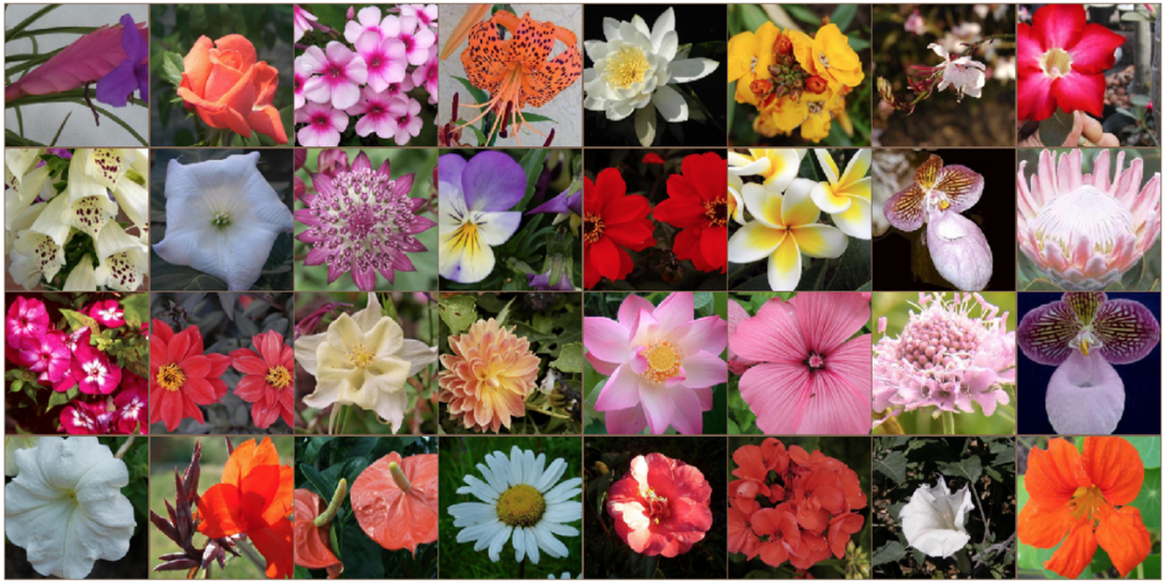
Dataset: Flower-102, by Maria- Elena Nilsback and Andrew Zisserman.

Slide 5
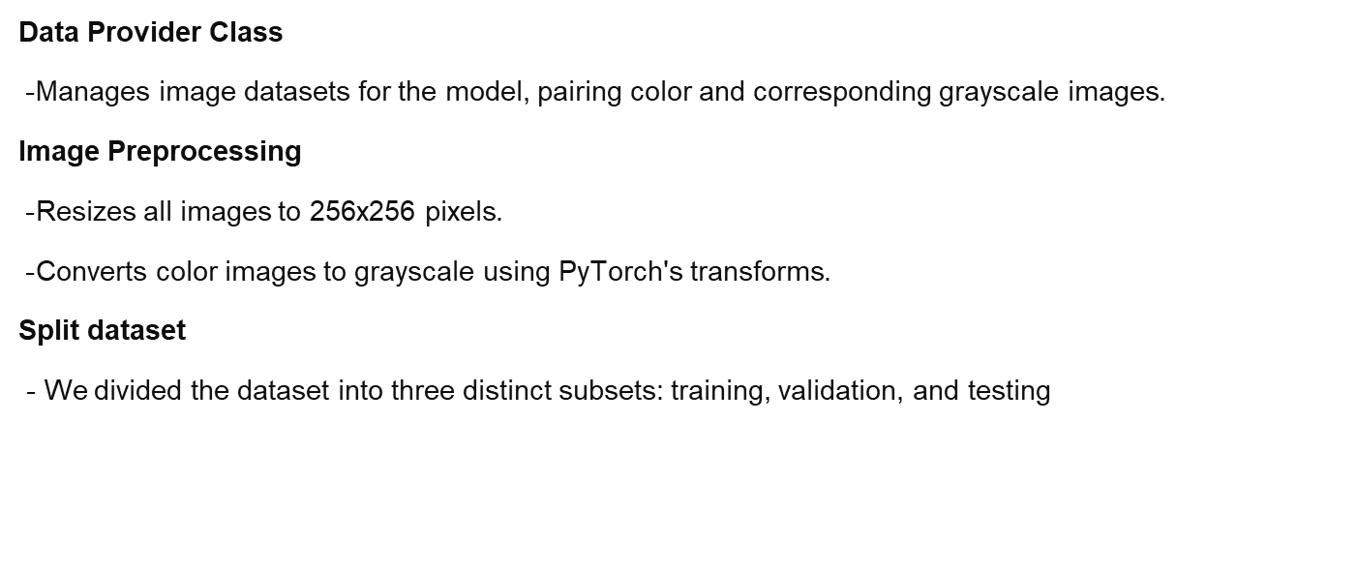
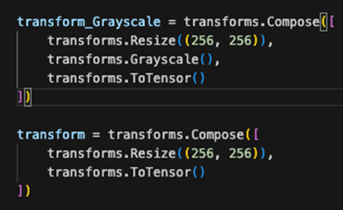
Data Management for Image Colorization

Slide 6
Generator and Discriminator
Generator: This part of the network is responsible for creating new data instances. In the case of UNet models, the generator typically includes both encoder and decoder parts. The encoder compresses the input into a latent space, and the decoder reconstructs the output from this latent space.
Discriminator (or Critic in some GAN variants like WGAN): This is a separate network that judges whether the output of the generator is real (like the actual data) or fake (produced by the generator). The discriminator does not involve decoding but rather evaluates the authenticity of the inputs it receives, which are either real data or fake data generated by the generator.
In traditional GANs, the discriminator's job is to classify inputs as real or fake.
In WGANs (Wasserstein GANs), the discriminator is often called a critic because it does not classify. Instead, it provides a score (not a probability) that measures how real or fake an input is, without categorizing it into discrete classes.

Slide 7
Architecture
The architecture implemented in this model is a GAN (Generative Adversarial Network) utilizing U-Net as the generator and a CNN for the discriminator. Both networks extensively employ VGG blocks to construct deep convolutional layers, optimized using the Adam optimizer.
Generator - U-Net Architecture:
Structure: Each layer of the U-Net generator consists of a VGGBlock, which is a series of two convolutional layers, each followed by batch normalization and ReLU activation. We use them because they are known for their simplicity and effectiveness in feature extraction. The network employs downsampling (encoder) followed by upsampling (decoder) with skip connections to preserve context and details.

Slide 8
Introduction to VGG Block in Neural Networks
Purpose: VGG Blocks are a fundamental building block used in many CNN architectures, known for their simplicity and effectiveness in feature extraction.
Configuration: Consists of consecutive convolutional layers followed by batch normalization and ReLU activation to introduce non-linearity.
Layer Setup: Two convolutional layers with 3x3 kernel size, padding set to maintain dimensionality, and batch normalization to stabilize learning.
Activation: ReLU (Rectified Linear Unit) activation function follows each convolutional layer to introduce non-linearity, enhancing the network's ability to learn complex patterns.

Slide 9
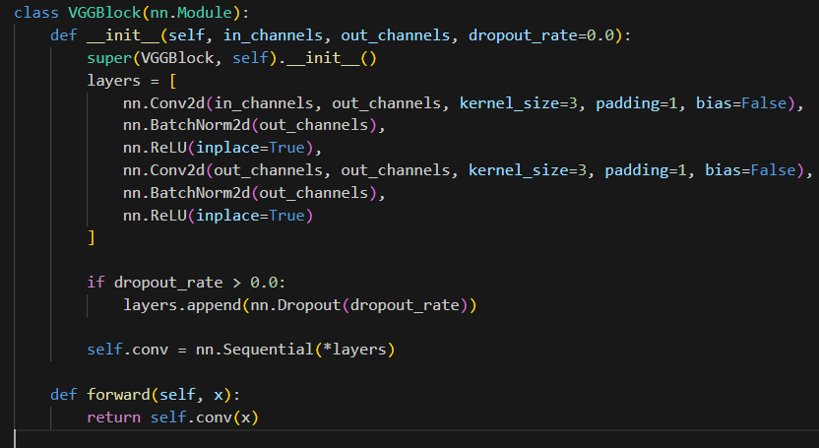

Slide 10
UNet Generator Architecture
Input Layer: Accepts 1-channel grayscale images, starting the processing pipeline for image transformation.
Downsampling Path Layers: Utilizes sequential VGG blocks, increasing in complexity from 1 to 1024 channels, designed to capture progressively deeper features.
Components: (VGG) Each block contains two convolutional layers followed by batch normalization and ReLU activation, extracting and normalizing feature representations.
Dimension Reduction: Max pooling is applied after each block to reduce spatial dimensions, concentrating feature details.
Upsampling Path Layers: Mirrors the downsampling structure but in reverse, gradually restoring the image's dimensions.
Feature Merging:Each layer includes upsampling and convolution, followed by concatenation with the corresponding downsampling layer to retain critical spatial hierarchies.
Output Layer: A final convolutional layer that converts the processed features into a 3-channel color image.

Slide 11
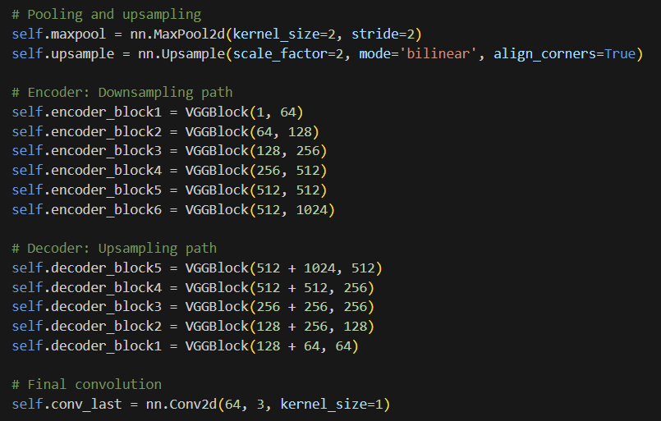

Slide 12
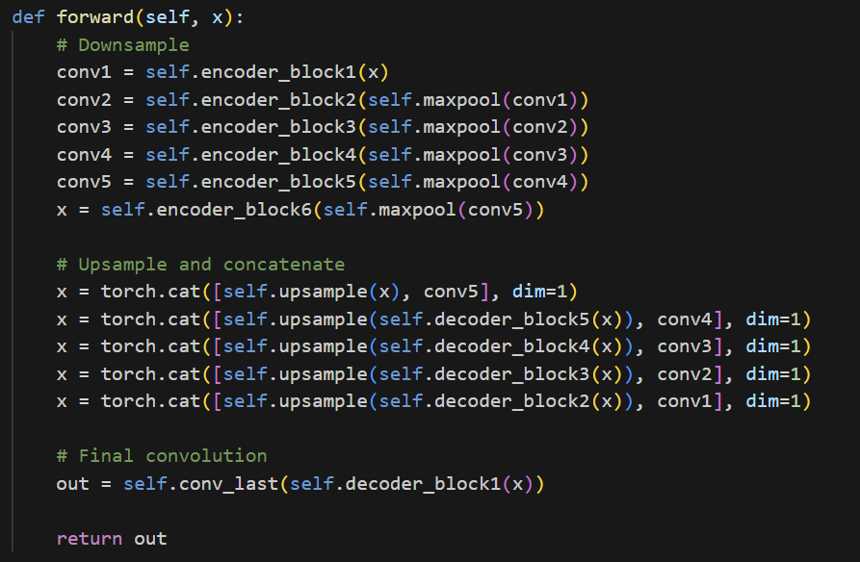

Slide 13
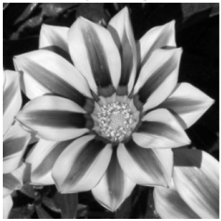
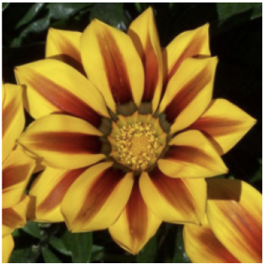
1x256x256
3x256x256
conv 3x3 batchNorm+ReLU 64x256x256
conv 3x3 batchNorm+ReLU 64x256x256
conv 3x3 batchNorm+ReLU 64x256x256
(192x256x256)
conv 3x3 batchNorm+ReLU 64x256x256
maxpool 2x2
64x128x128
upconv 2x2
128x256x256
conv 3x3 batchNorm+ReLU 128x128x128
conv 3x3 batchNorm+ReLU 128x128x128
conv 3x3 batchNorm+ReLU 128x128x128
conv 3x3 batchNorm+ReLU 128x128x128
(384x128x128)
maxpool 2x2
128x64x64
upconv 2x2
256x128x128
conv 3x3 batchNorm+ReLU 256x64x64
conv 3x3 batchNorm+ReLU 256x64x64
conv 3x3 batchNorm+ReLU 256x64x64
(512x64x64)
conv 3x3 batchNorm+ReLU 256x64x64
maxpool 2x2
256x32x32
upconv 2x2
256x64x64
conv 3x3 batchNorm+ReLU 512x32x32
conv 3x3 batchNorm+ReLU 256x32x32
conv 3x3 batchNorm+ReLU 512x32x32
(1024x32x32)
conv 3x3 batchNorm+ReLU 256x32x32
maxpool 2x2
512x16x16
upconv 2x2
512x32x32
conv 3x3 batchNorm+ReLU 512x16x16
conv 3x3 batchNorm+ReLU 512x16x16
conv 3x3 batchNorm+ReLU 512x16x16
(1536x16x16)
conv 3x3 batchNorm+ReLU 512x16x16
maxpool 2x2
512x8x8
upconv 2x2
1024x16x16
conv 3x3 batchNorm+ReLU 1024x8x8
conv 3x3 batchNorm+ReLU 1024x8x8

Slide 14
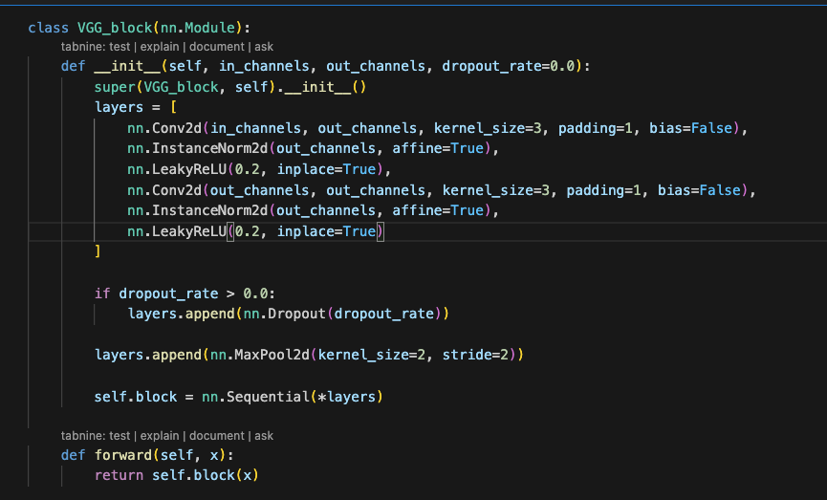
Discriminator Architecture - CNN
Layers: Sequential VGG blocks with Instance Normalization and LeakyReLU, increasing in depth from 3 to 1024 channels.Function: Each block contains two convolutional layers with ReLU and batch normalization to stabilize learning.
Final Layer: A convolution that outputs a single value to determine real or fake.

Slide 15
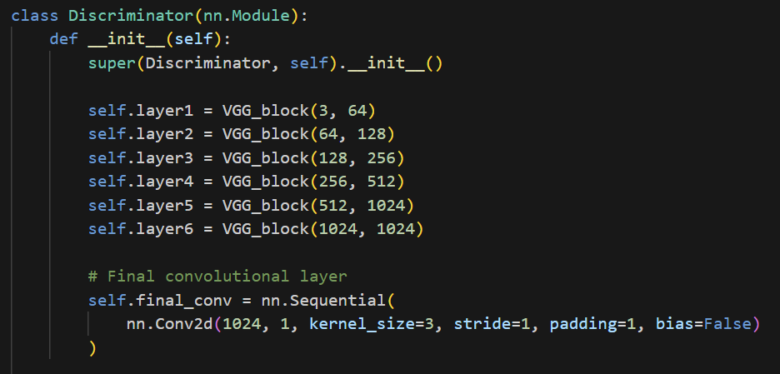
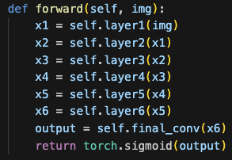
Discriminator Architecture - CNN

Slide 16
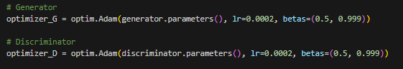
Optimizer Selection
Optimizer Used: All UNet models utilize the Adam optimizer. This choice is based on its proven effectiveness in handling the complexities of image data, as it adapts the learning rates for each parameter, facilitating faster and more stable training.

Slide 17
Training
In this training loop, both the generator and discriminator of a GAN are trained iteratively over a set number of epochs (350). During each epoch (4 batches - 255 images each one), the discriminator is trained first by alternating between real and fake images, where it learns to distinguish genuine images from those generated by the generator. The generator is then trained to fool the discriminator by minimizing a combined loss, which includes an adversarial loss that makes the generated images more realistic and an loss function that reduces the pixel-wise difference between the generated and real images.

Slide 18
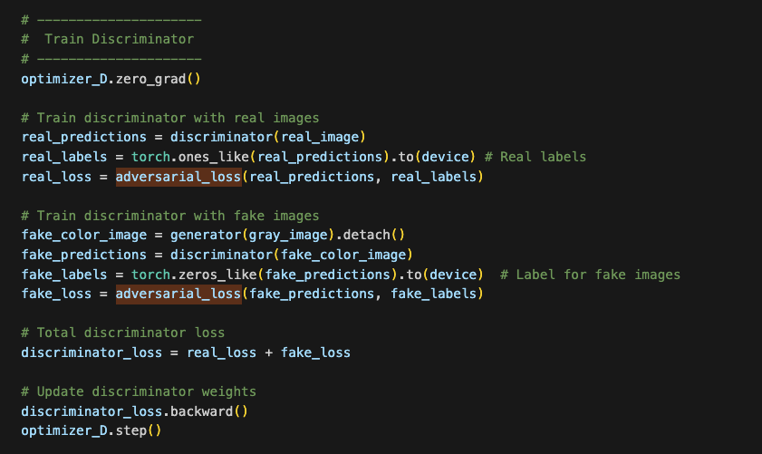

Slide 19
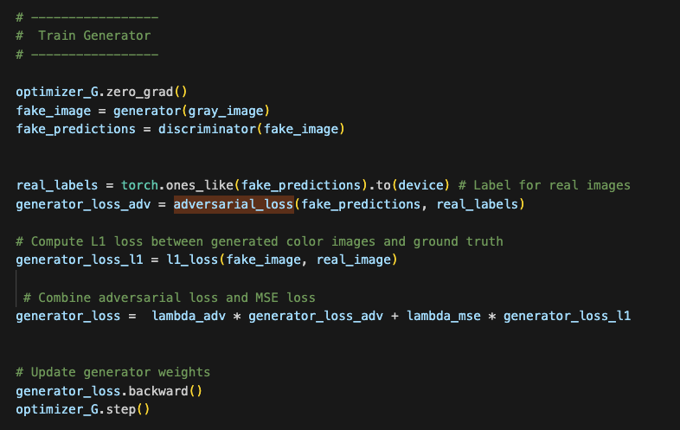

Slide 20
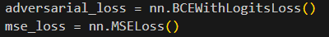
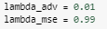
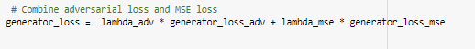
GAN + MSE
The Generator Loss was a linear combination of an MSE Loss and a GAN loss which was calculated using the discriminator.

Slide 21
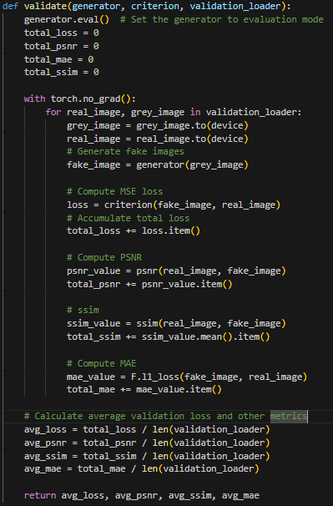
Validation & Testing
for Validation we create a function: validate function sets the generator to evaluation mode and measures its performance on a validation dataset by computing metrics such as MSE loss, PSNR, SSIM, and MAE for each batch. It returns the average values of these metrics across the entire validation dataset, providing insights into the model's generalization ability and image quality reproduction.

Slide 22
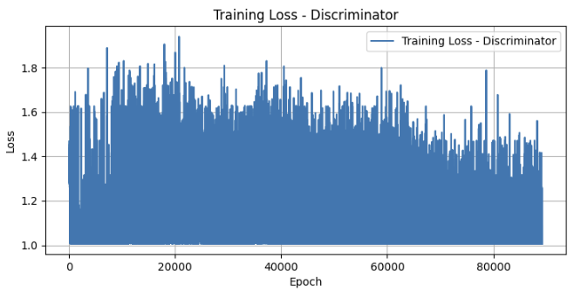
GRAPHS RESULT GAN+MSE
The graph displays the training loss for the discriminator (real_loss + fake_loss), showing fluctuations but a general decrease in loss, indicating learning and optimization progress over time.

Slide 23
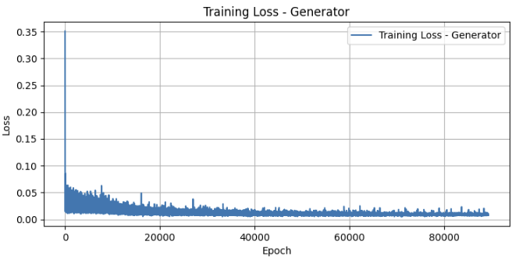
The training loss for the generator- it decreases sharply at first, indicating rapid learning, and then stabilizes, demonstrating consistent performance as training progresses.

Slide 24
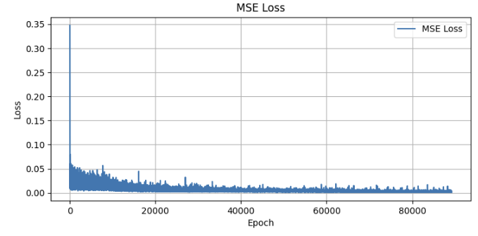
The MSE loss graph displays a rapid initial decline and reaches a plateau quickly, indicating the model's loss has stabilized and is converging as training continues.

Slide 25
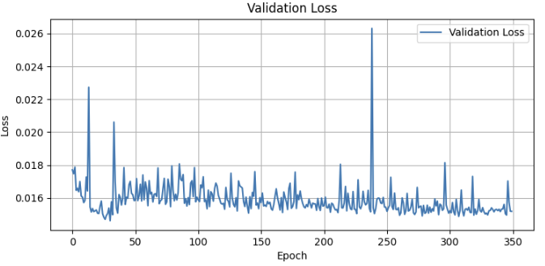
The validation loss chart indicates a modest but consistent decrease, punctuated by occasional spikes, reflecting a stable yet imperfect learning trajectory.

Slide 26
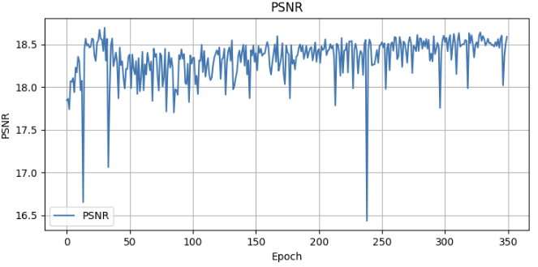
The PSNR graph shows slight variations within a narrow range, indicating that image quality, as measured by peak signal-to-noise ratio, is relatively stable throughout the epochs.

Slide 27
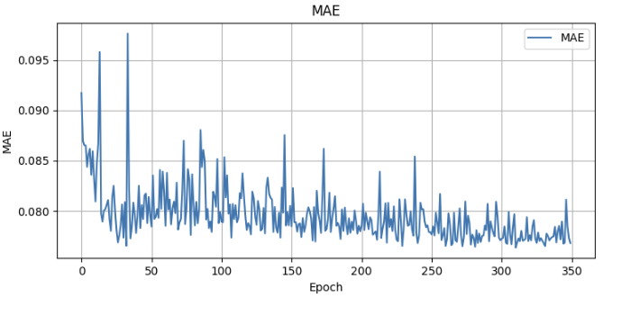
The MAE graph shows a decrease and then levels out, indicating the model’s predictions are gradually aligning closer to the actual values as training progresses.

Slide 28
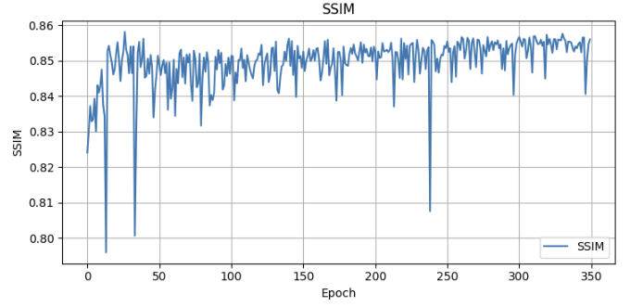
The SSIM graph shows minor fluctuations, indicating a stable model performance in preserving image structures over the training epochs with slight adjustments.

Slide 29
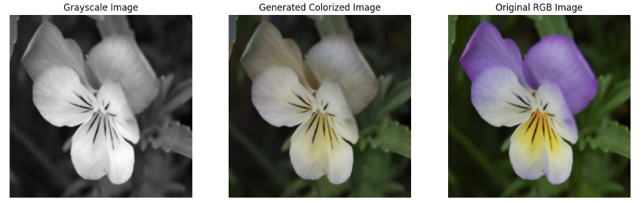
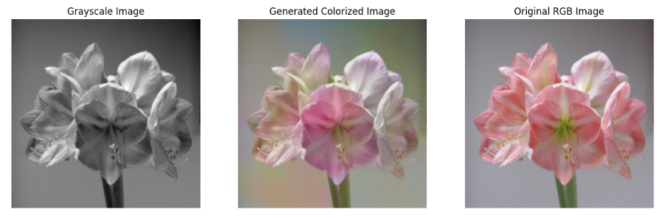
Test Results GAN+MSE

Slide 30
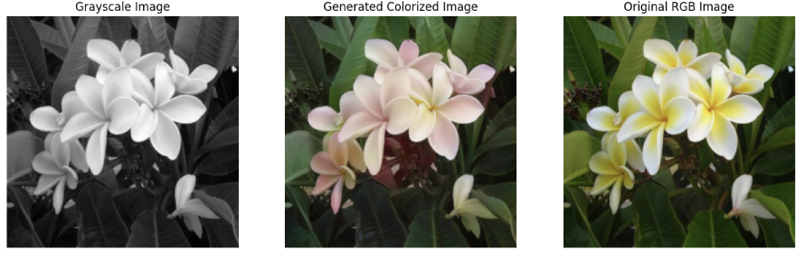
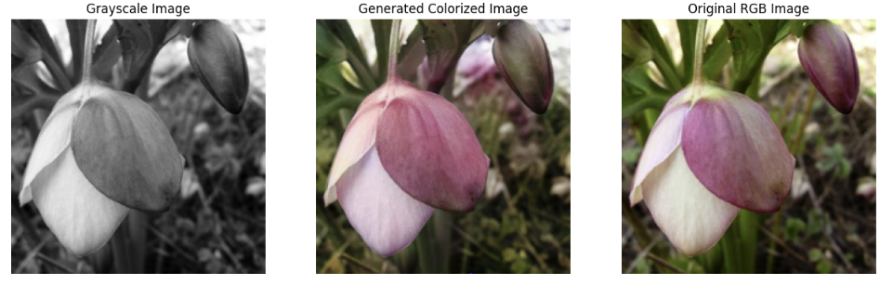

Slide 31
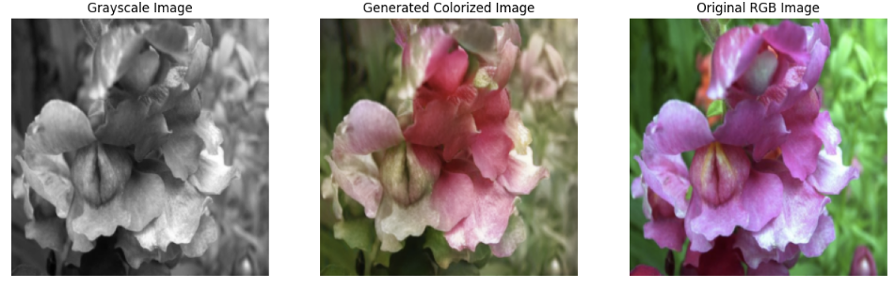
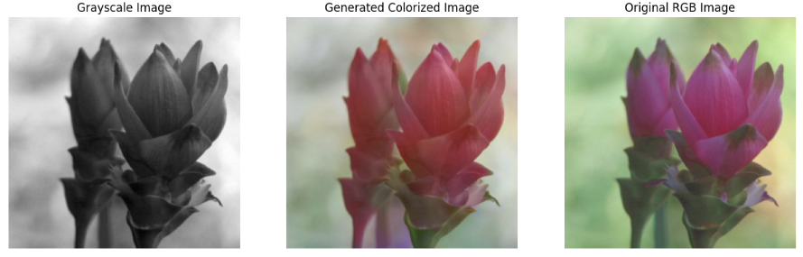

Slide 32
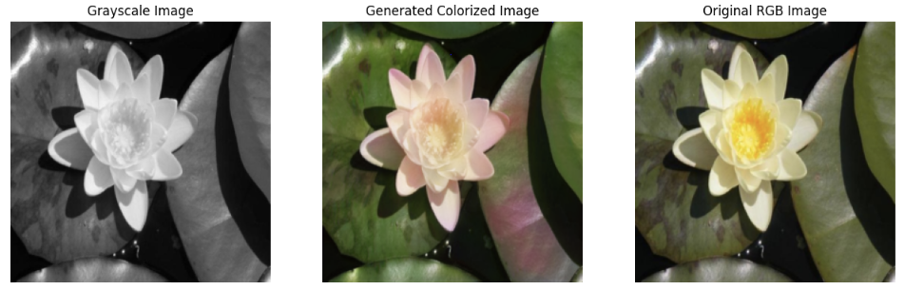
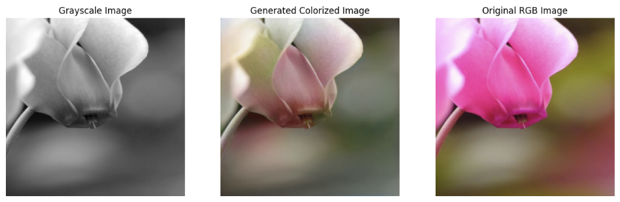

Slide 33
Transformation to L1
We were not satisfied with the initial results, so we searched the internet for ways to improve them. We found that using the L1 loss function instead of MSE can lead to better outcomes because it makes the images sharper and clearer L1 loss tends to produce sharper images compared to MSE loss..

Slide 34
Advantages of Using L1 Loss in Image Colorization:
Less Blurring: L1 loss tends to produce sharper images compared to MSE loss. This is because L1 loss penalizes large errors linearly, while MSE loss penalizes them quadratically. As a result, L1 loss encourages the generator to produce pixel values closer to the ground truth, leading to less blurring in the generated images.
Robustness to Outliers: L1 loss is less sensitive to outliers compared to MSE loss. Since L1 loss calculates the absolute differences between pixel values, it is less influenced by extreme outliers in the data.
Simplicity and Efficiency: L1 loss is computationally simpler and often faster to calculate than more complex loss functions. This simplicity makes it a popular choice for real-time applications and systems with limited computational resources.

Slide 35
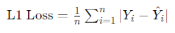
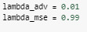
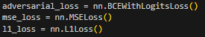
GAN + L1
The Generator Loss was a linear combination of an L1 Loss and a GAN loss which was calculated using the discriminator.
In each epoch we trained the Generator and the discriminator.
The L1 loss (also known as Mean Absolute Error, MAE) in images measures the average of the absolute differences between predicted and actual pixel values:
Here, is the actual pixel value, is the predicted pixel value, and is the total number of pixels. Lower L1 loss indicates a more accurate prediction.

Slide 36
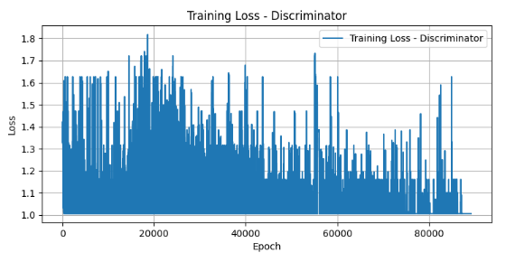
GAN + L1 GRAPHS
The discriminator’s training loss graph features a downward trend with noticeable variability across epochs.

Slide 37
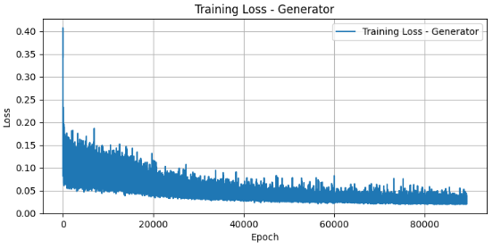
The generator's training loss graph indicates a steep initial decline, followed by a plateau, which suggests an early rapid learning phase that stabilizes as training progresses.

Slide 38
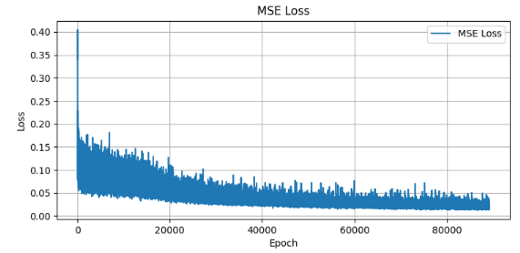
The MSE loss chart demonstrates a quick initial drop and then steadies, hinting at the model’s stabilizing performance.

Slide 39
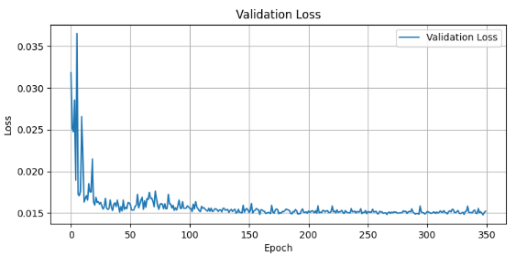
The graph for validation loss decreases sharply at the start and then maintains a relatively flat line, indicating the model’s consistent performance after the initial training period.

Slide 40
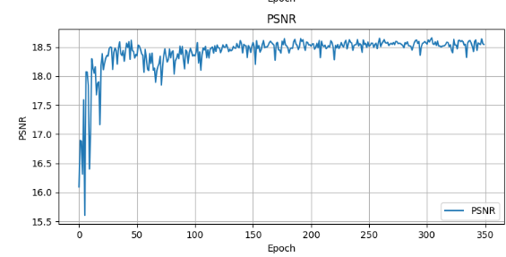
The PSNR graph initially rises quickly and then plateaus, indicating early improvements in image quality that stabilize as training proceeds.

Slide 41
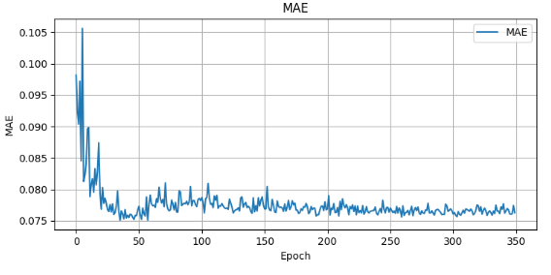
The MAE graph shows a steep decline early in training, leading to a stable, low error as more epochs are completed.

Slide 42
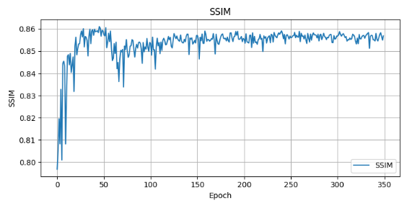
The SSIM graph climbs sharply at the start and then remains consistently high, suggesting the model consistently preserves image structural integrity throughout training.

Slide 43
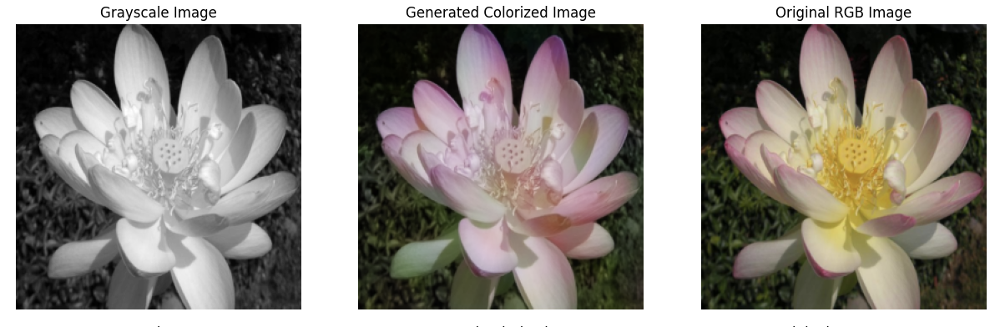
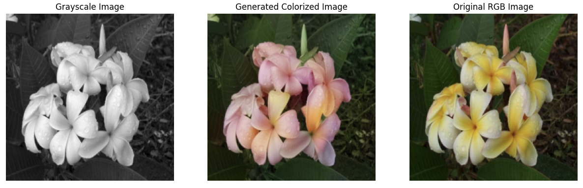
IMAGES TEST RESULTS GAN+L1

Slide 44
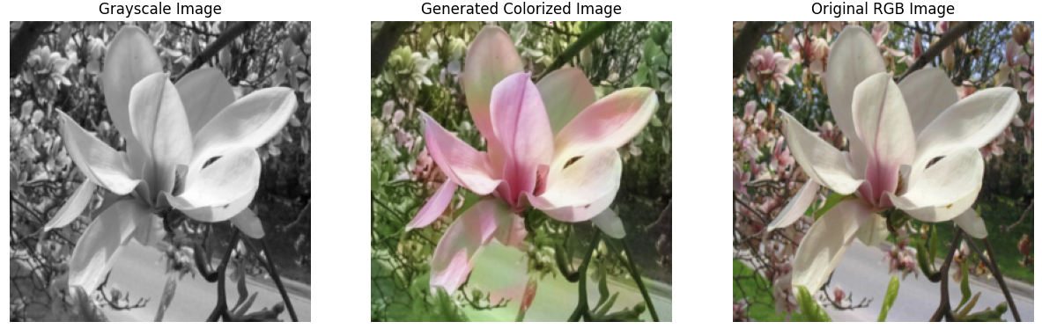
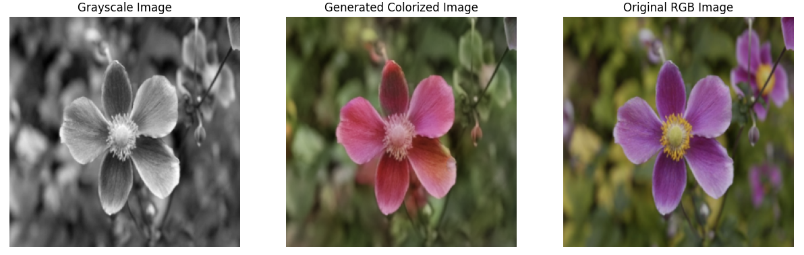

Slide 45
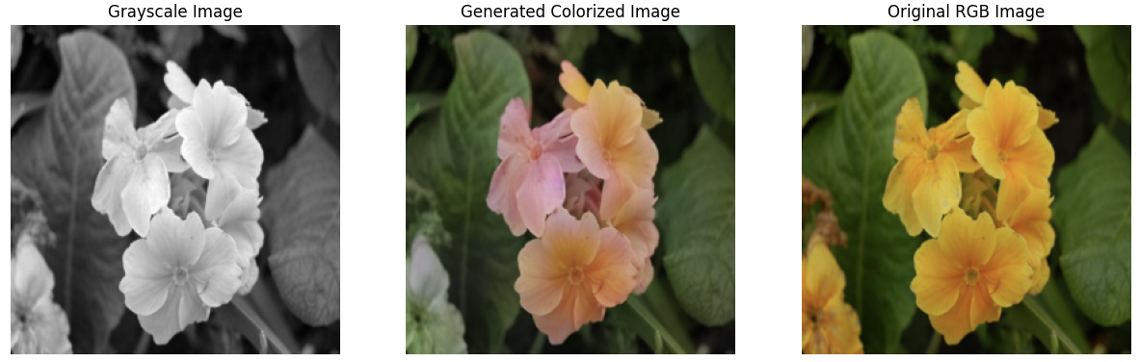
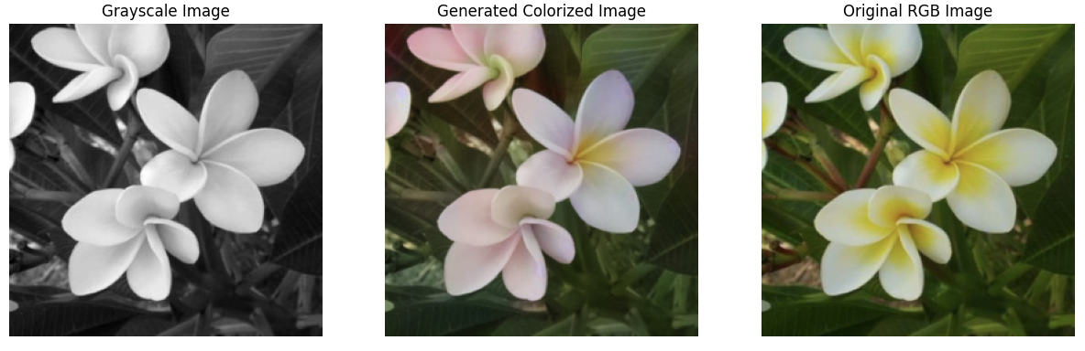

Slide 46
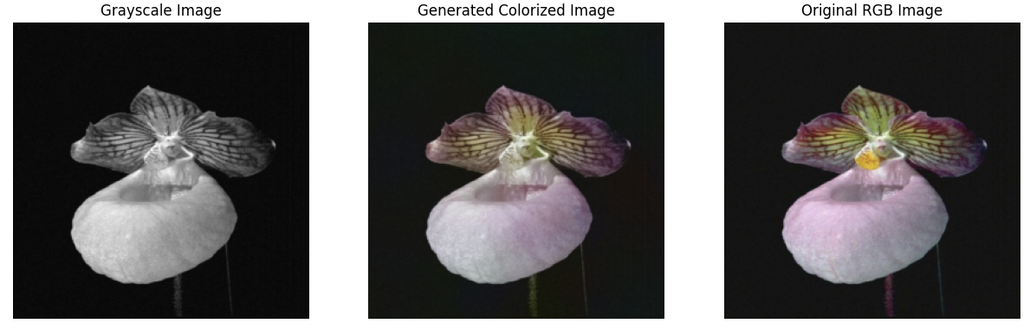


Slide 47
Final Selection
In our opinion, L1 loss is better than MSE because it results in more stable and converging graphs. Visually, there is also a slight improvement in the output images; they appear more realistic.
This improved stability and realism highlight the practical benefits of L1 loss in enhancing both model performance and visual fidelity in our image processing tasks

Slide 48
WGAN
At the beginning of our project, we initially developed a model using the WGAN (Wasserstein Generative Adversarial Network) approach. However, this model required extensive computational resources and a very long training period—approximately two and a half weeks. Despite our efforts to train and refine the model, the substantial time required led us to reassess and ultimately change our approach due to these time constraints.

Slide 49

Encoder & Decoder
EncoderBlock:
- Convolutional Layer: Reduces spatial dimensions by half using a stride of 2.
- Batch Normalization: Normalizes features to stabilize learning.
- ReLU Activation: Adds non-linearity, improving the ability to capture complex patterns.
DecoderBlock:
-Transposed Convolutional Layer: Increases spatial dimensions to reconstruct features.
-Batch Normalization and ReLU Activation: Ensures smooth and effective feature enhancement during reconstruction.

Slide 50

WGAN - Unet Model
WGAN Unet Architecture
Encoder: Starts with a layer of 64 channels, increasing to 128, 256, 512, and up to 1024, using convolutional layers to reduce dimensions progressively.
Decoder: Consists of five decoder blocks, mirroring the encoder in reverse, from 1024 channels back down to 64, with skip connections at each stage for detail recovery.
Objective: Employs Wasserstein loss with gradient penalty, enhancing training stability and image quality.

Slide 51

The forward method in the UNetGenerator handles the encoding and decoding within the U-Net architecture. It compresses the input through successive encoder layers, then expands it using decoder layers, incorporating skipped connections from encoder outputs to preserve detail. This process supports accurate reconstruction for tasks like image segmentation.

Slide 52


Training
We found this algorithm in the internet and we used it as reference.
*mini_batch- is the amount of random images for the critic training.

Slide 53
Before presenting the results, it's important to note that due to the lengthy training time required, we were only able to complete 21 epochs, with each set of 8 epochs taking approximately 12 hours. Therefore, the results you're about to see reflect the model's performance after these 21 epochs of training.

Slide 54

WGAN - Results

Slide 55


Slide 56


Slide 57


Slide 58
Model running instructions:
upload GAN-L1 notebook to Google Colab, and download the model for the link below:
https://drive.google.com/file/d/1aHGpMl5VdSlpQUCmUJnsR8ONWL2k_MOr/view?usp=share_link
now upload the model to your Google drive.
copy the path to model from your Google drive and paste it in this line (last block)
run the first block (where all the imports are) and the second block (under the headline Generator - UNET)
run the last block
enjoy the results!

